Slide 1
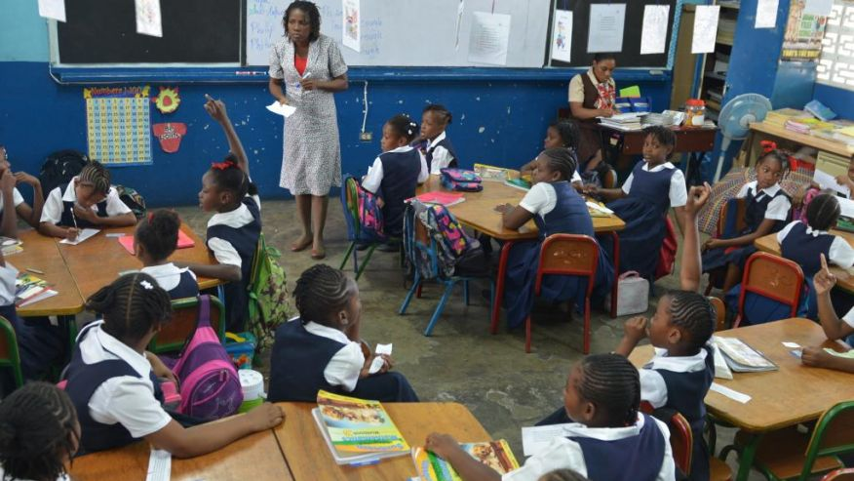
CPEA PERFORMANCE
2014 AND 2015

Slide 2
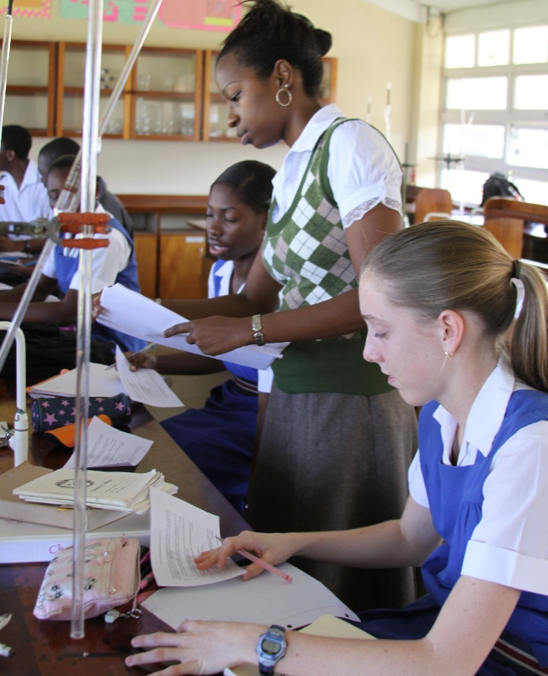
May – June 2015 EXAMINATION RESULTS
Presentation in collaboration
with the Ministry of Education Science, Technology and Innovation of Barbados
14 August 2015

Slide 3
CARIBBEAN PRIMARY EXIT ASSESSMENT CANDIDATE ENTRIES 2014 – 2015

Slide 4
CANDIDATE PERFORMANCE

Slide 5
EXTERNAL ASSESSMENT
PERFORMANCE

